Slide 1
JOURNEY PPT Technical Onboarding - Week 4 Custom IDA Bootcamp
Afrin Siddiqui – IDA
Supervisory Organization: PTIY/FBD CC HR and Corporate (Pankaj Janak Kumar) (59726509)
Position Title: 54077724 Associate Data Engineer
Location: Bangalore RMZ-ECO WORLD
Employee ID: 654991

Slide 2
Day 1 – Azure Synapse Analytics
Learned about Azure Synapse both as SQL Pool (Serverless) and Dedicated SQL Pool
Concept of MPP – Massisve Parallel Processing was explained in context of Azure Storage.
Data Movement Service (DMS) which is basically the data transport technology coordinates data movement between nodes.
Table partitions which are divided amongst clustered columnstore (Read only data), Clustered index (Physical index) and Heap (Data stored in random order).

Slide 3
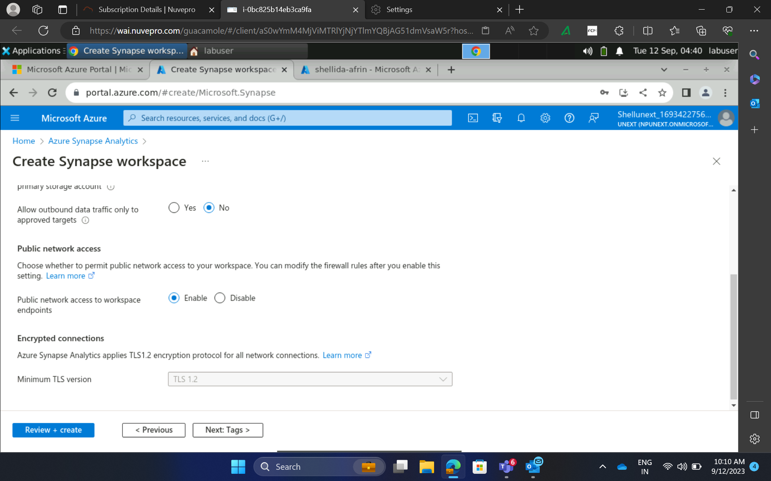

Day 1– Hands on training/ Practical Work

Slide 4
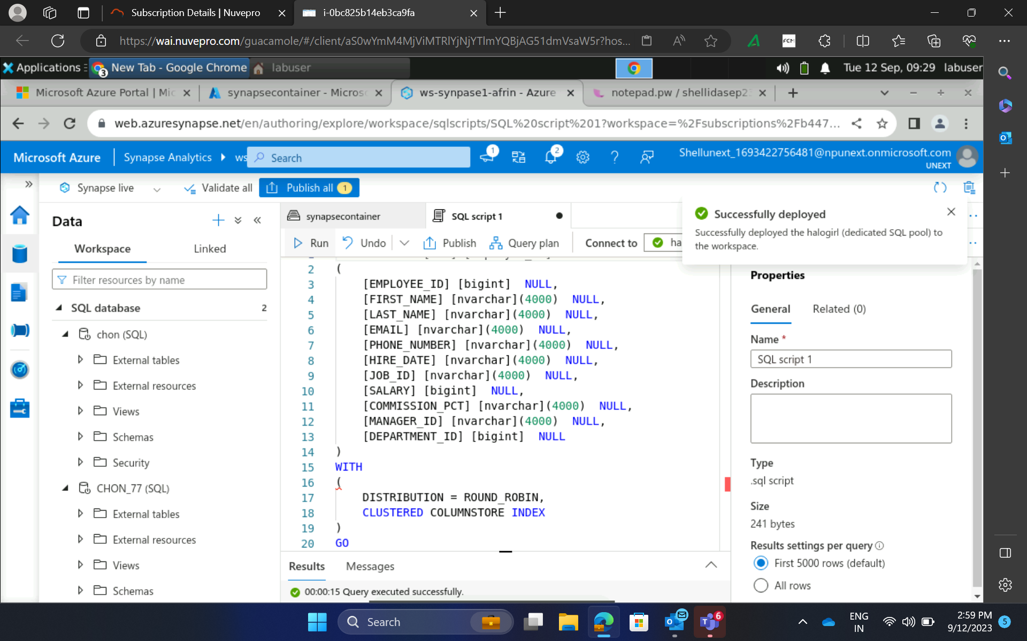
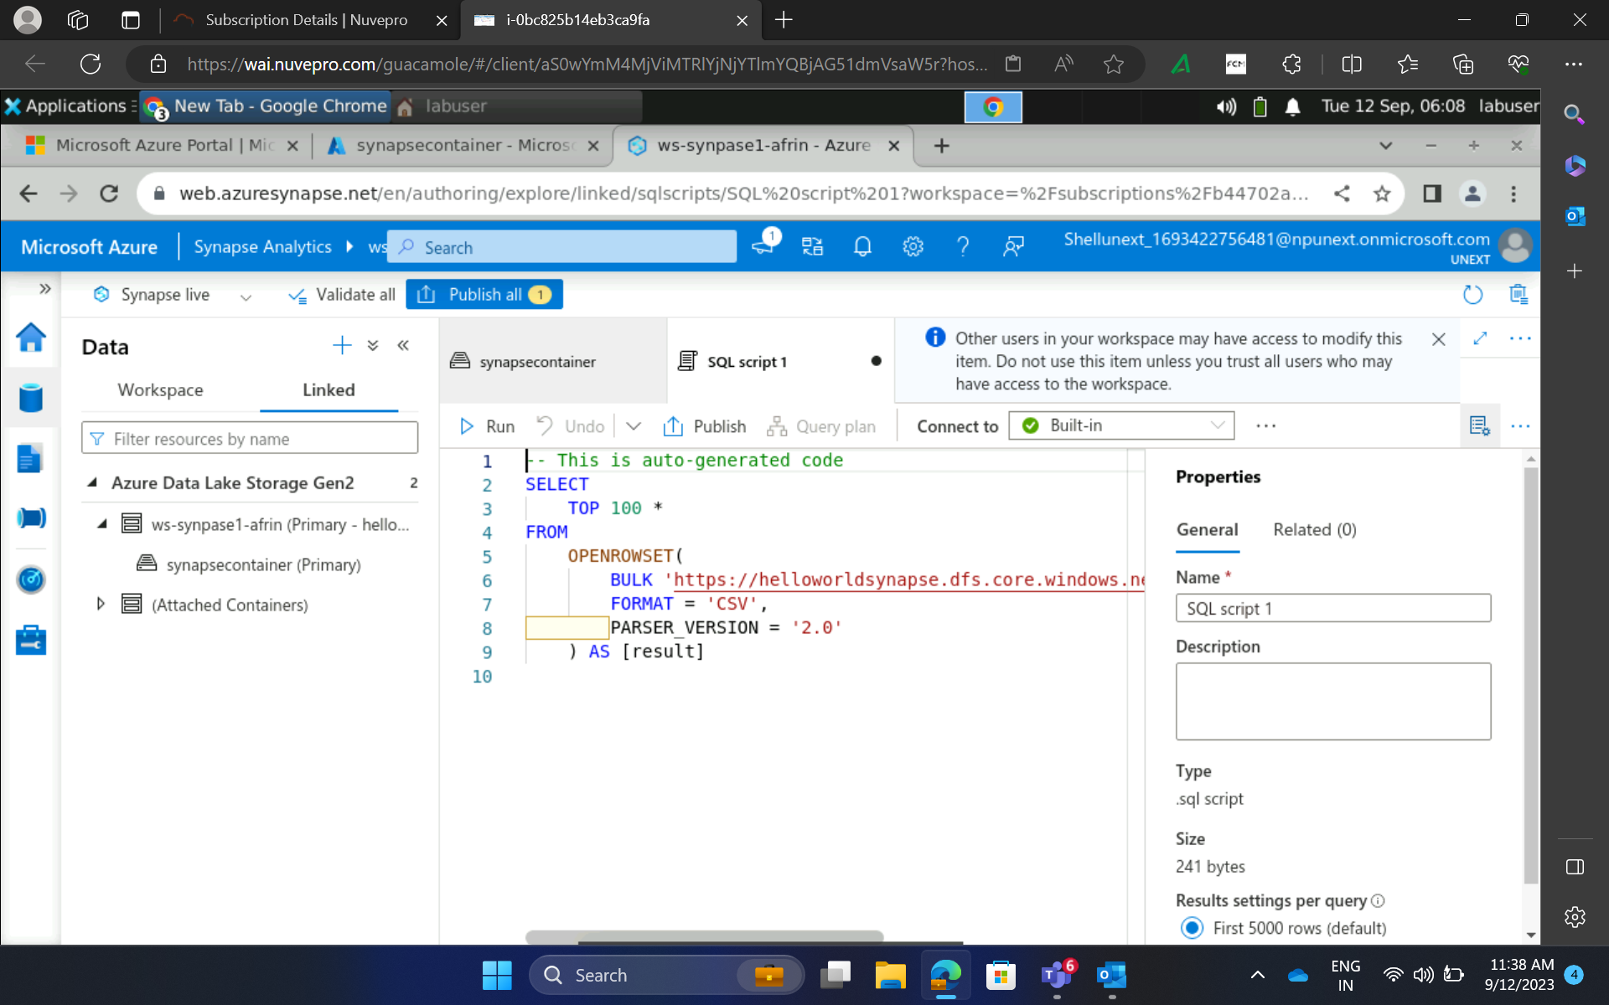
Day 1– Hands on training/ Practical Work

Slide 5
Day 2 – Introduction to PowerBI
Concept of data visualization with PowerBI
Learned how to create interactive data reports which provide reasonable and actionable insights about our data
Understood how PowerBI caters to business analysis by giving us insight onto customer behviour and shopping patterns
How to connect SQL servers and PowerBI (Import and Export of files)

Slide 6
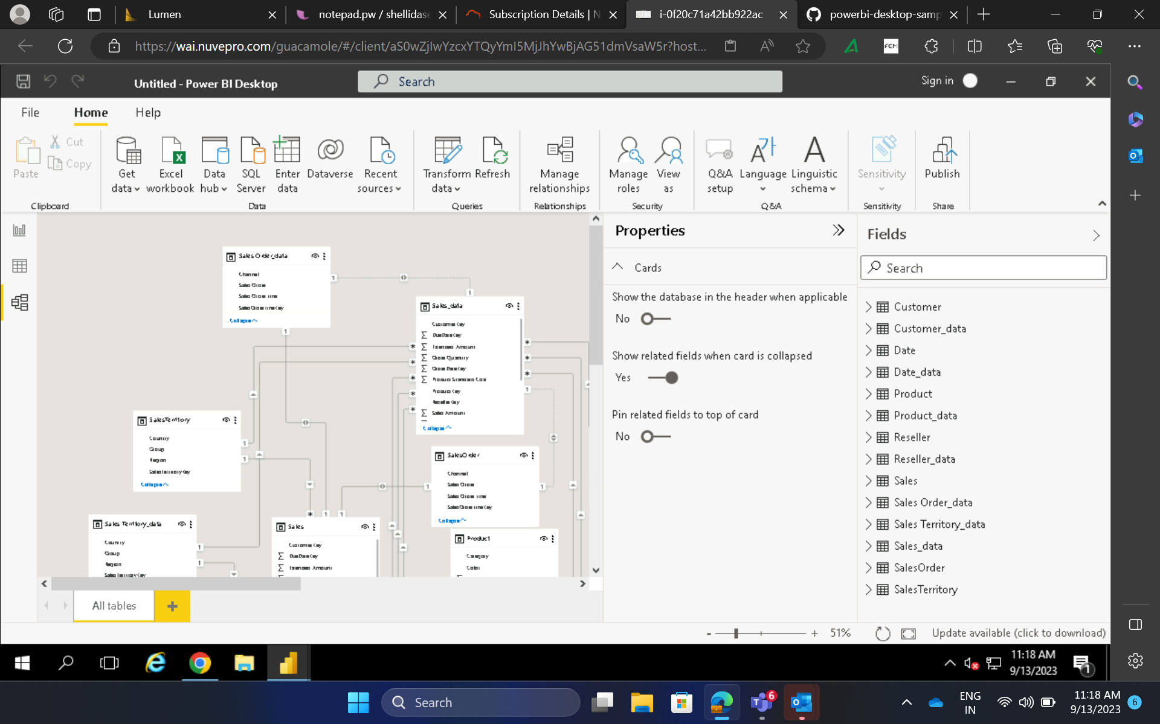
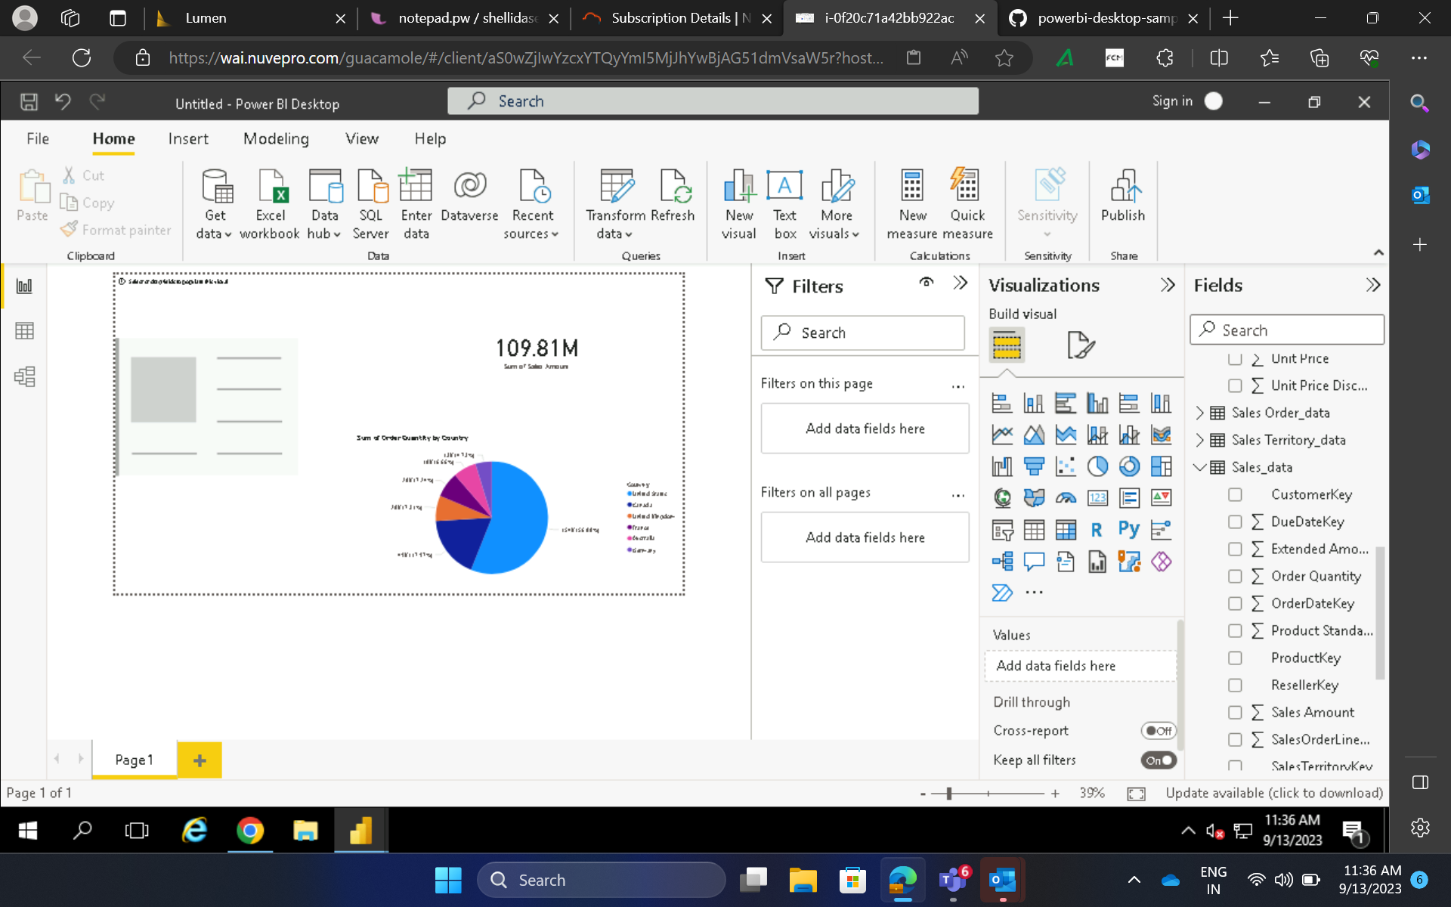
Day 2 – Hands on training/ Practical Work

Slide 7
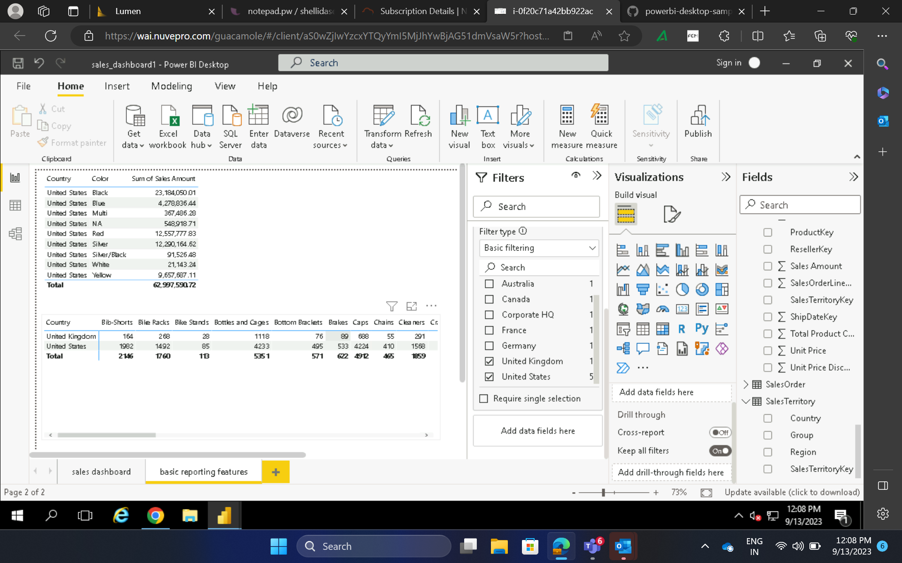
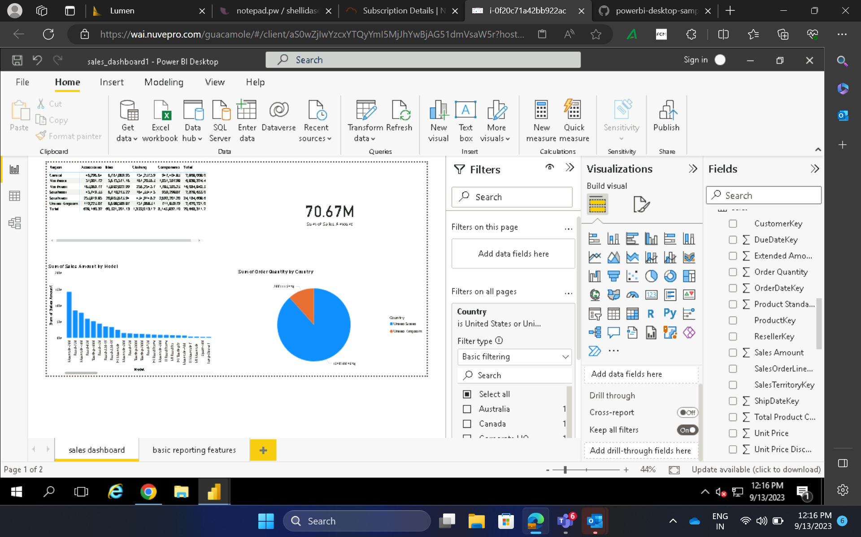
Day 2 – Hands on training/ Practical Work

Slide 8
Day 3 – PetroCorps Case Study
Did practical training which consisted of setting VM machines, connecting SQL database with Power BI desktop and writing appropriate SQL queries.
Imported database onto SQL server and performed activities to create insightful dashboards in PowerBI (Merging Tables, Transformations and extraction)

Slide 9
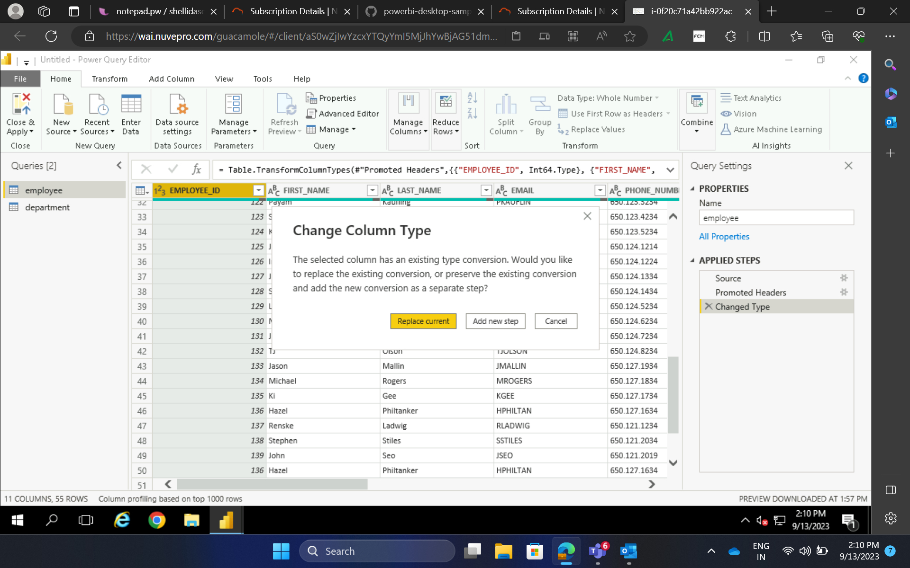
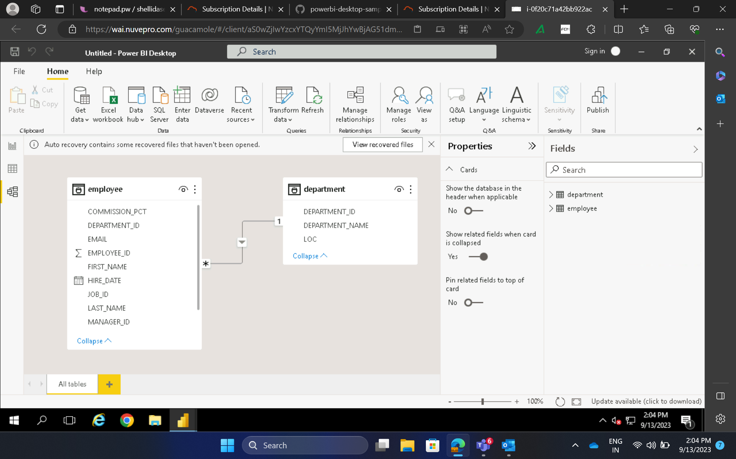
Day 3 – Hands on training/ Practical Work

Slide 10
Day 4 – Scenario based Case Study and Introduction to Python
Successfully submitted the scenario based case study on time.
Made insightful dashboards based on Sales Performance data and fulfilled the necessary requirements
Brief introduction to python and real life applications based on python

Slide 11
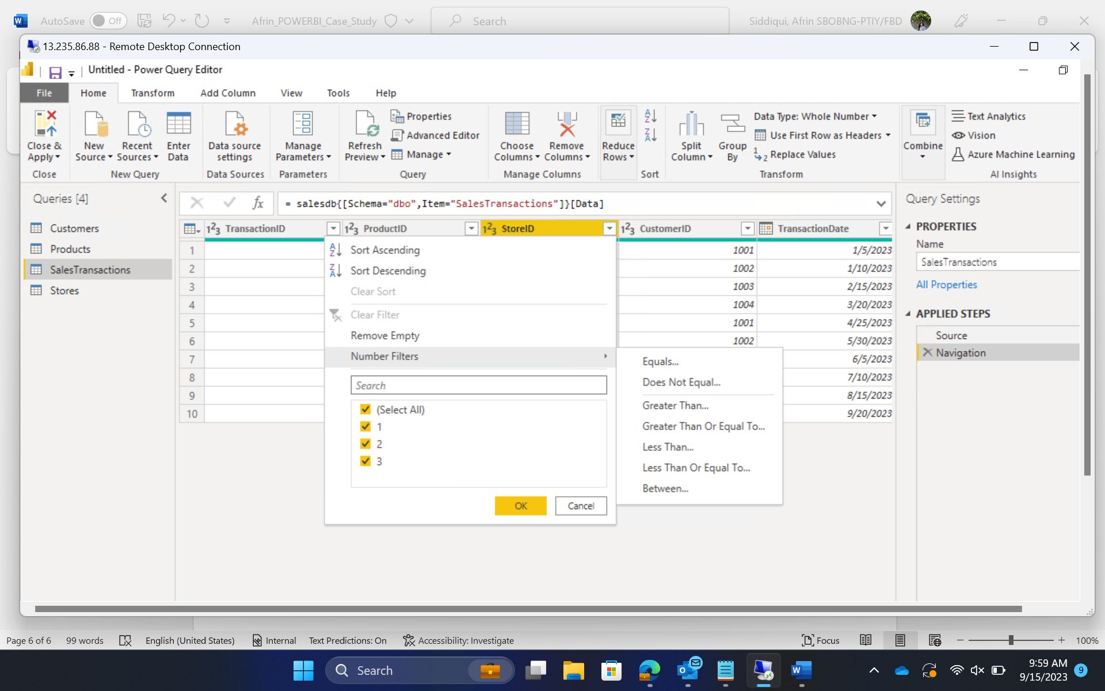
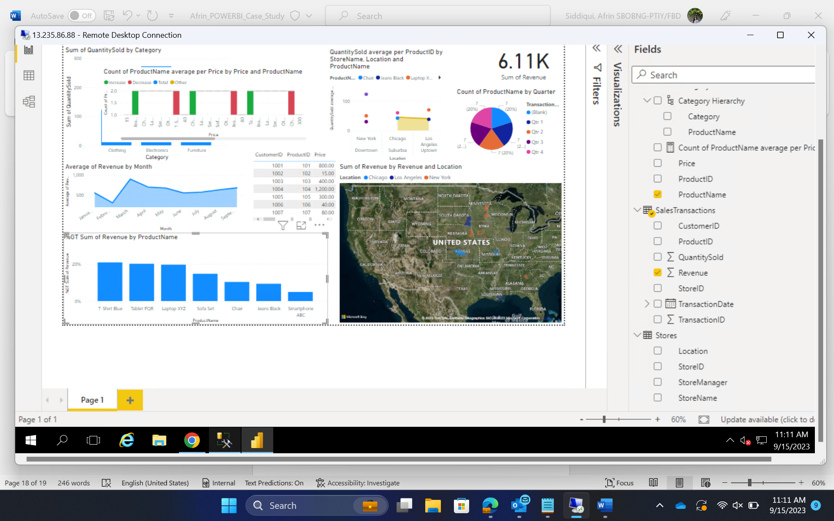
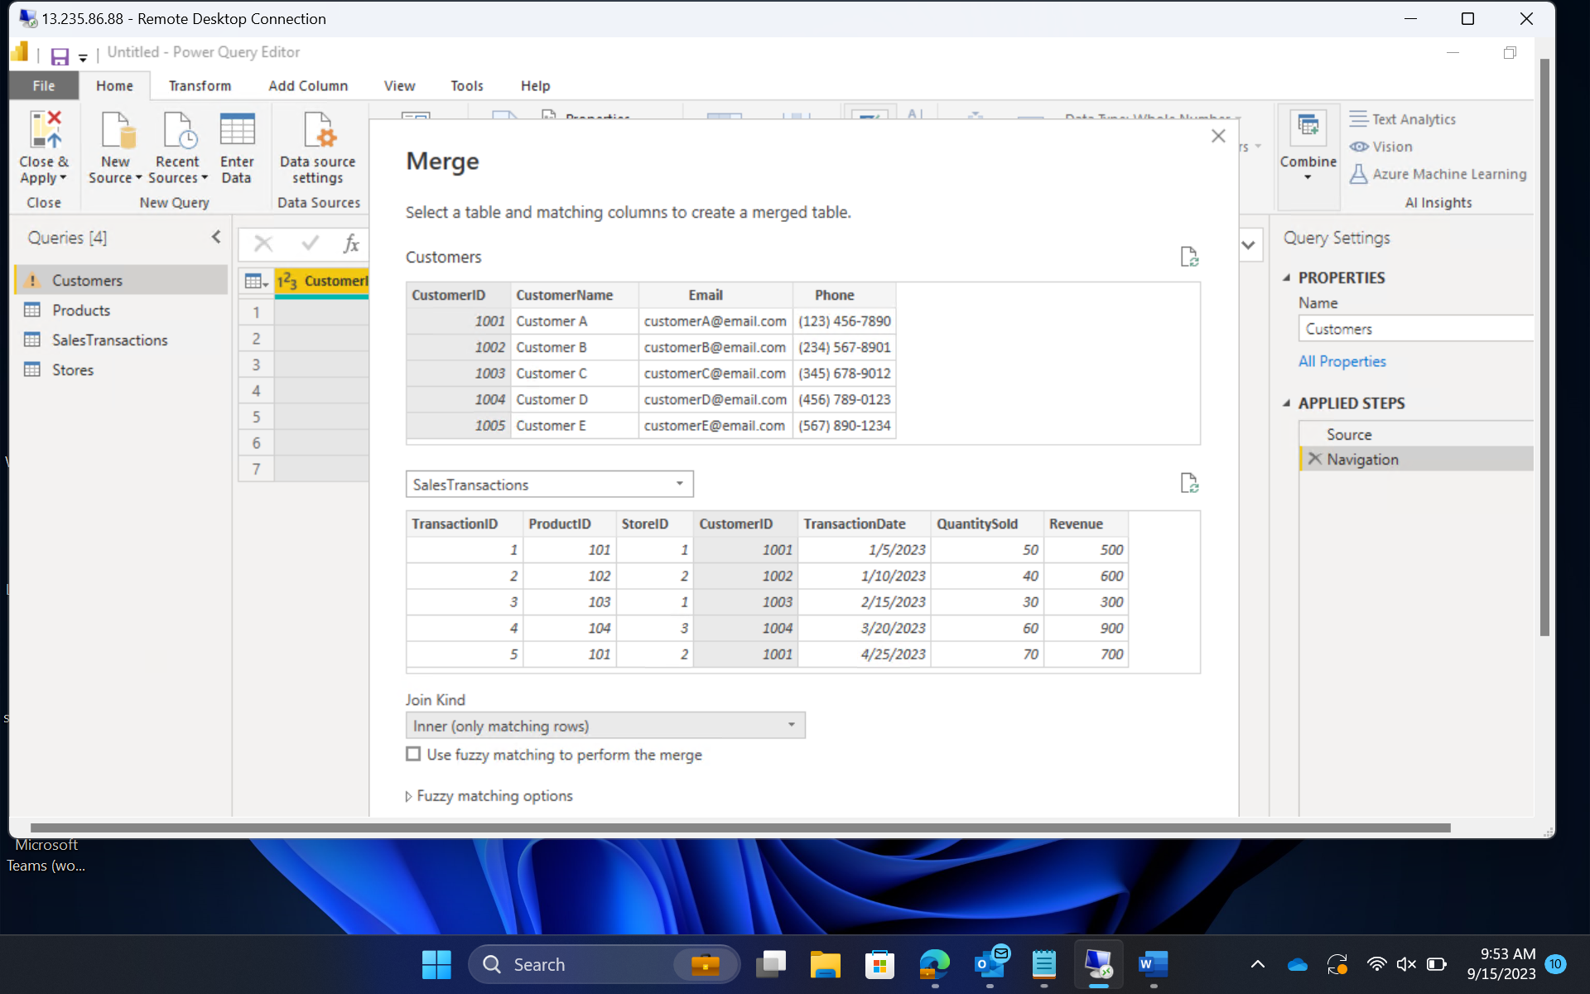
Day 4 – Hands on training/ Practical Work

Slide 12
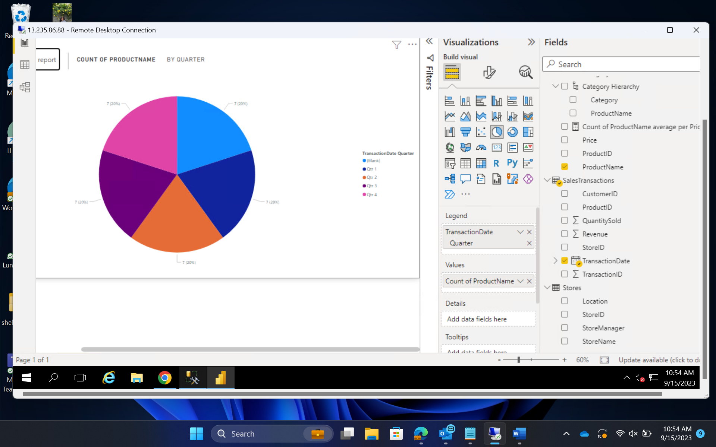
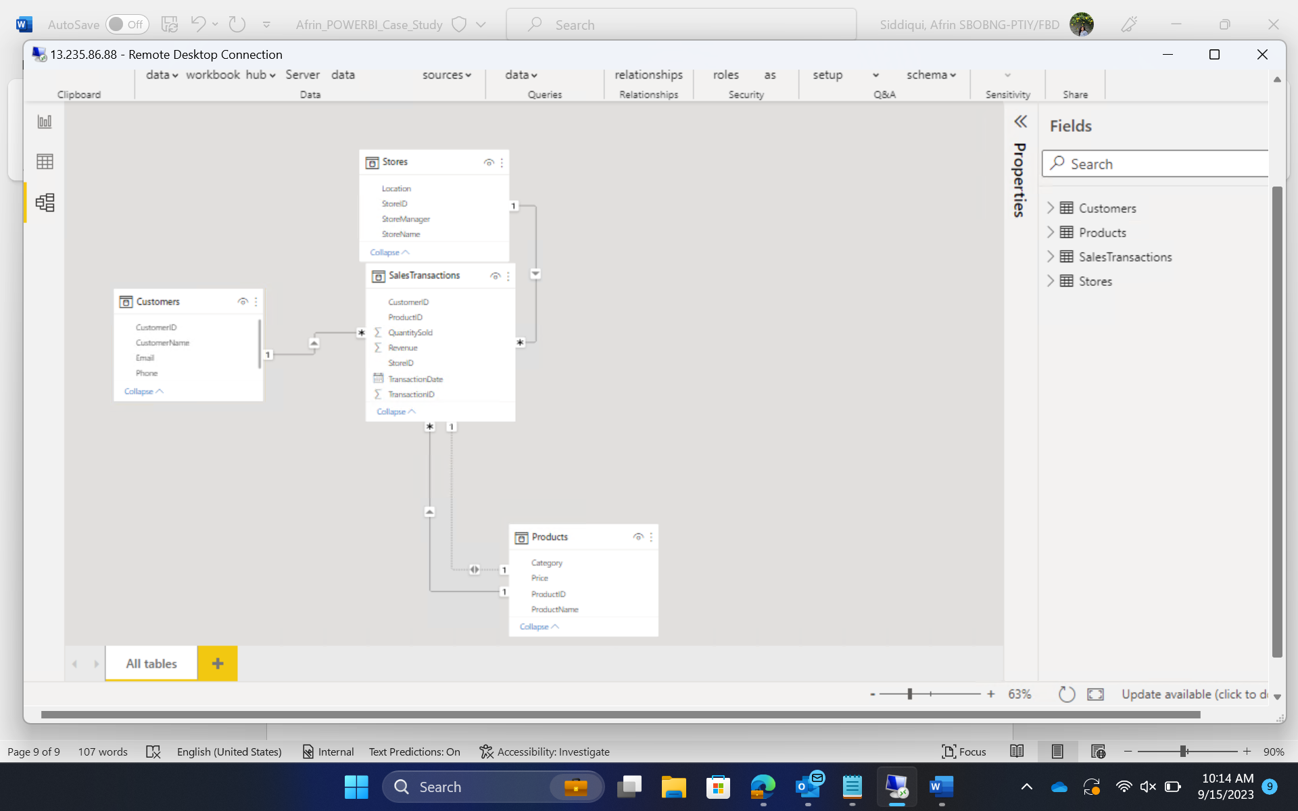
Day 4 – Hands on training/ Practical Work

Slide 13
NOTE
There was no bootcamp training on 11th September, 2023 (Monday) as there was a transport strike.

Slide 14


